Slide 1
CyberSecurity in Fintech

Slide 2
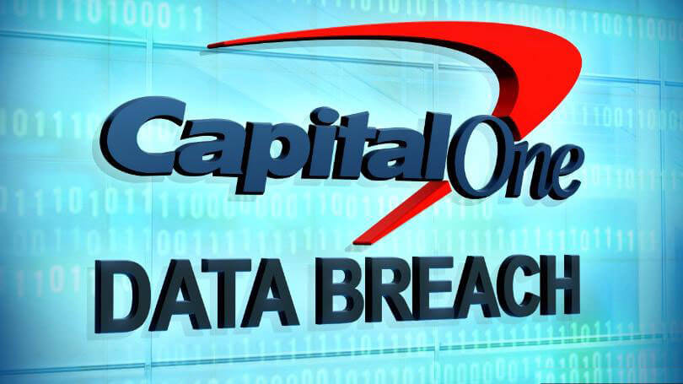
Capital One Data Breach
The breach was discovered in July 2019.
The personal information of over 100 million customers in the United States and 6 million customers in Canada was compromised.
The breach occurred due to a misconfigured web application firewall.
80 Million Dollars Fined

Slide 3
Outline
The Transformative Era of Fintech
Escalating Threat Landscape
Regulatory Requirements
Impacts of Cyber Events
Building Cyber Resilience
Securing Fintech's Digital Future
AI and Cybersecurity

Slide 4
The Transformative Era of Fintech
The landscape of the fintech industry has started in a transformative era.
However, this rapid digitization brings forth heightened cybersecurity risks.
Investment Inflows, Changing Consumer Behaviour, Acceleration of Digital transformation, Diversity of Fintech offerings.

Slide 5
Escalating Threat Landscape
Fintech firms face a cyber risk 300 times higher than other sectors, with over 1,800 breaches in 2021.
Attacks are escalating globally, exploiting valuable data.
Ransomware poses a major danger, threatening to encrypt critical systems, and failing to secure data damages reputation.

Slide 6
Regulatory Requirements
Fintech companies, must comply with regulations like GLBA, PCI-DSS, and GDPR, complicating their cybersecurity efforts.
Regulators target cybersecurity, making compliance imperative to avoid penalties and ensure the security of financial data.

Slide 7
Impacts of Cyber Events
Successful cyber attacks lead to financial fraud, non-compliance fees, and legal actions
Reputational damage becomes a substantial loss.
Disruption of critical systems emphasizes the need for substantial cybersecurity investment in the fintech sector.

Slide 8
Building Cyber Resilience
Governance and Culture:
Establishing clear security policies, frameworks, and risk management programs.
Promoting a cybersecurity culture, emphasizing commitment and providing workforce training.
Leveraging Advanced Technologies:
Implementing AI, machine learning, blockchain, and cloud solutions for enhanced cybersecurity.

Slide 9
Building Cyber Resilience (cont'd)
Security Controls and Monitoring:
Enforcing tight access controls and a zero-trust model.
Continuous monitoring of endpoints, networks, and transactions.
Regular penetration testing and cyber incident response plans.
Third-Party and Supply Chain Risk Management:
Vigilant approach to auditing vendors and partners for cyber risks.
Integrating security requirements into contracts and maintaining contingency plans.

Slide 10
Securing Fintech's Digital Future
As financial services digitize, cyber risks to fintech companies will continue rising.
Cybersecurity and resilience must be top priorities embedded into organizational cultures and processes.
Ongoing investment in mature cyber programs allows fintechs to balance innovation with rigorous protection, upholding customer trust in the financial system.

Slide 11
CyberSecurity and AI
Intelligent Threat Detection
Adaptive Authentication and Biometrics
Predictive Security Analytics

